Slide 1
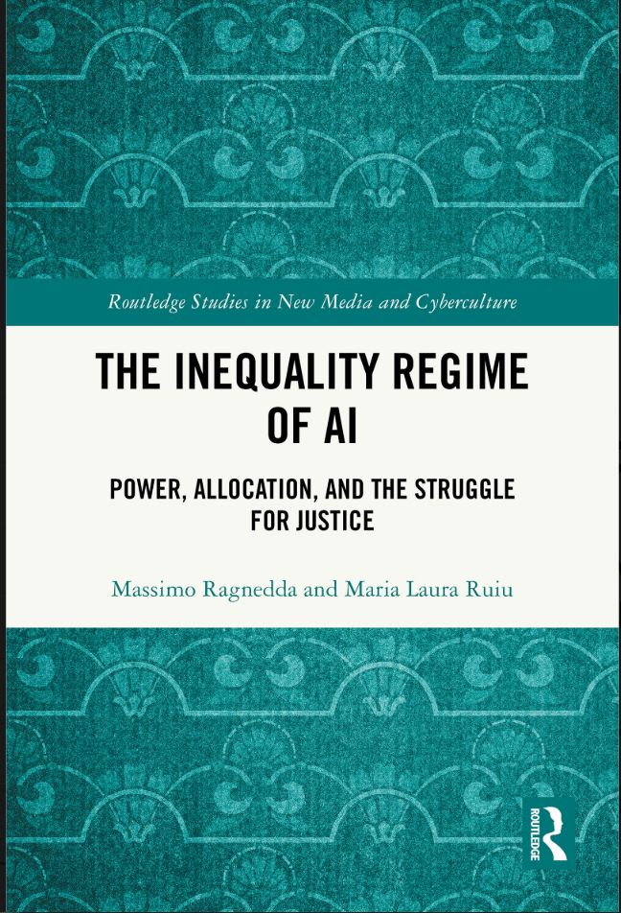
SAMPLE TEACHING DECK
The Inequality Regime of AI
Power, Allocation, and the Struggle for Justice
Massimo Ragnedda & Maria Laura Ruiu
Designed for one 90-120 minute class
Advanced UG / PG
The book is the leading source throughout. Every substantive slide points back to the relevant chapter.
Routledge | DOI 10.4324/9781003689379
Notes:
Opening slide. Frame this as a concept-driven class rather than a book promotion. The teaching deck is a scaffold: students should encounter the book itself as the primary reading.

Slide 2
CLASS DESIGN
How to use this deck
Primary format
Optional split
Core reading
One 90-120 minute class combining explanation, a short mapping activity, and discussion.
Class 1: Slides 1-13 - diagnosis and mechanisms.
Class 2: Slides 14-20 - subjectivity, political economy, and alternatives.
Introduction + Chapter 1 or 2. Add Chapter 3 for a theory-heavy class.
Learning outcomes
Distinguish access/participation from prediction/allocation
REFLECT
If you split the material, end Class 1 after students map where the spiral can be interrupted.
Analyze AI as a sociotechnical and institutional system
Explain the three fractures and the Stratification Spiral
Connect micro, institutional, global, and ecological inequality
Evaluate redistributive alternatives
Leading source: Expanded Teaching Guide + book Introduction / Chs. 1-3
Notes:
Timing note: this slide should take 2 minutes. Explain that the deck is designed as one class; the split is only an optional adaptation.

Slide 3
OPENING PROBLEM
Why “algorithmic bias” is not enough
Bias asks whether a model treats groups differently.
The regime question asks something larger:
From isolated outputs
to architectures of power
1
Who defined the problem?
2
Who controls the data and model?
Prediction becomes sociologically consequential when institutions use it to allocate opportunities, resources, protections, visibility, or risk.
3
What institution acts on the prediction?
4
Who receives benefits, burdens, risk, or scrutiny?
5
Who can contest or redesign the system?
REFLECT
Can a model be statistically fair while the institution using it remains unequal?
Leading source: Introduction; Ch. 1
Further reading: Ananny & Crawford (2018); Benjamin (2019)
Notes:
Opening discussion: ask students for one example of a “fair” system that could still serve an unequal institutional purpose. Do not resolve the question yet.

Slide 4
HISTORICAL BRIDGE
From digital divides to predictive allocation
1
2
3
4
5
ACCESS
SKILLS
OUTCOMES
PREDICTION
ALLOCATION
Who can connect?
Who can use?
Who benefits?
Who is classified?
Who gets what?
Earlier digital inequalities do not disappear. They become inputs into a new layer of inequality organized through prediction and allocation.
REFLECT
What changes when digital systems begin to anticipate future risk, value, compliance, or eligibility?
Leading source: Ch. 2, “From Digital Divides to the Allocative Turn”
Further reading: Eubanks (2018); Fourcade (2021)
Notes:
Use this as the bridge from classic digital divide theory. Stress continuity: access and skills still matter, but they no longer exhaust the inequality problem.

Slide 5
CORE FRAMEWORK
The AI Inequality Regime
AI as a social, institutional, and infrastructural order
The regime organizes
DATA
What becomes visible
visibility
value
ALGORITHMS
voice
opportunities
How visibility is interpreted
resources
risk
GOVERNANCE
Whose rules become authoritative
REFLECT
What makes an unequal pattern durable enough to call it a regime?
Leading source: Introduction; Chs. 1-3
Further reading: Acker (2006); Joyce & Cruz (2024)
Notes:
Definition slide. Avoid treating “regime” as rhetorical emphasis. It is meant to capture a durable ordering of relations across data, algorithms, institutions, and governance.

Slide 6
THREE PROPERTIES
Why call it a “regime”?
1
2
3
DURABILITY
GOVERNING LOGIC
NORMALIZING FORCE
Inequality persists across systems, domains, and time.
Defaults, incentives, classifications, and exclusions shape what becomes actionable.
Hierarchies can appear as optimization, efficiency, or personalization rather than political choice.
The key question is not only whether AI produces unequal outcomes, but how inequality becomes embedded, routinized, and difficult to contest.
Leading source: Ch. 1
Further reading: Benjamin (2019); Zajko (2023)
Notes:
Ask students to distinguish a one-off discriminatory error from a recurring governing arrangement. These three properties help operationalize the term regime.

Slide 7
DATA • ALGORITHM • GOVERNANCE
Three fractures structure AI inequality
DATA
ALGORITHM
GOVERNANCE
visibility
interpretation
authority
Who appears - and under what terms?
Who can turn data into categories and decisions?
Who sets purposes, rules, accountability, and redress?
REFLECT
The fractures are interdependent. Fixing one does not automatically transform the others.
Leading source: Ch. 3
Further reading: Birhane (2021); Crawford (2021); Milan & Treré (2019)
Notes:
Set up the next three slides. Stress that the fractures are not three separate checklists; they interact recursively.

Slide 8
VISIBILITY, VALUE, AND REPRESENTATION
The Data Divide
Data are made, not simply found.
INVISIBILITY
DATA DIVIDE ≠
“not enough data”
Who is absent from beneficial datasets?
MISREPRESENTATION
Whose lives are forced into categories that do not fit?
It is a question of who becomes machine-legible, in what categories, and for whose benefit.
HYPER-VISIBILITY
Who is overrepresented in punitive or surveillance datasets?
EXTRACTION
Who generates predictive value without control or return?
REFLECT
Can “more data” solve inequality if the categories and purposes remain unchanged?
Leading source: Ch. 3, § Data Divide
Further reading: Benjamin (2019); Couldry & Mejías (2019); Eubanks (2018)
Notes:
Use the contrast among invisibility, misrepresentation, hyper-visibility, and extraction. Inclusion in data is not automatically emancipatory.

Slide 9
INTERPRETIVE POWER
The Algorithmic Divide
Who has the power to turn data into decisions?
Those who interpret
Those who are interpreted
• design models
• receive scores
• set parameters
• face rankings
• choose labels
• experience filters
• define optimization goals
SENSE-MAKING
POWER
• bear errors
• audit / contest
• rarely inspect the system
REFLECT
Explainability matters - but who gets to define what counts as a good explanation?
Leading source: Ch. 3, § Algorithmic Divide
Further reading: Pasquale (2015); Ananny & Crawford (2018)
Notes:
The algorithmic divide is not just a skills gap. It is an asymmetry in interpretive authority and the capacity to audit, contest, and define what counts as fairness or harm.

Slide 10
RULE-MAKING AND RESPONSIBILITY
The Governance Divide
PURPOSE
Who decides what the system is for?
Private systems can exercise public power
RULES
Who sets thresholds, standards, and acceptable risks?
Vendors, agencies, platforms, regulators, and standards bodies can share authority so diffusely that responsibility becomes difficult to locate.
ACCOUNTABILITY
Who is responsible when harms emerge?
CONTESTATION
Who can challenge or reverse a decision?
REFLECT
Who governs when authority is distributed across code, vendors, agencies, and standards?
Leading source: Ch. 3, § Governance Divide
Further reading: Cohen (2019); Dencik & Kaun (2023)
Notes:
This slide turns the conversation from “transparency” to authority. Ask where formal and practical sovereignty are located when institutions outsource computational infrastructure.

Slide 11
FROM PARTICIPATION TO PREDICTION
The Allocative Turn
Prediction becomes a political act when institutions act on it.
DATA
PREDICT
CLASSIFY
INSTITUTION
ALLOCATE
history
future risk / value
score / rank / category
decision
opportunity / burden
The shift is from systems that mediate social participation to infrastructures that organize life through probabilistic expectations of future behavior.
REFLECT
At what point does a prediction become an allocation of life chances?
Leading source: Ch. 2
Further reading: Eubanks (2018); Fourcade (2021)
Notes:
Use one institutional example and follow it all the way through the flow. The crucial step is not prediction itself but the institutional decision that gives prediction consequences.

Slide 12
RECURSIVE INEQUALITY
The AI Stratification Spiral
REFLECT
Where could the spiral be interrupted - and which interventions leave the larger loop intact?
UNEQUAL
CONDITIONS
NEW OUTCOMES
+ DATA
DATA
INSTITUTIONAL
DECISION
CLASSIFICATION
Historically contingent inequality can become statistically “common sense” when outputs generate the data used for future prediction.
Leading source: Chs. 1 & 3
Further reading: Bowker & Star (1999); Fourcade & Healy (2017)
Notes:
This is the central mechanism slide. Emphasize recursion: unequal conditions enter data, institutions act on classifications, and those actions alter future data.

Slide 13
10-15 MINUTES
Class activity: map an AI allocation system
Choose one domain: hiring • welfare • education • health • credit • migration • policing • public services
1
DATA
2
PREDICTION
3
CONTROL
What data are collected? Whose histories?
What is scored or classified?
Who owns data, model, compute?
4
ALLOCATION
5
FEEDBACK
6
CONTESTATION
What decision follows? Who gains/loses?
What new data does the decision create?
Who can challenge, refuse, or redesign?
Debrief: Which proposed intervention changes an output - and which changes the conditions under which prediction acquires authority?
Leading source: Expanded Teaching Guide, Activity 1; book Chs. 2-3
Notes:
Recommended group activity. Give students 6-8 minutes to map, then 4-5 minutes to compare intervention points. Optional split: end Class 1 here.

Slide 14
MICRO-POLITICS OF THE SELF
Algorithmic Habitus
ALGORITHMIC ENVIRONMENT
ADAPTIVE SELF
RANKINGS
optimize visibility
RECOMMENDATIONS
calibrate tone
SCORES
curate profiles
FILTERS
avoid penalties
SURVEILLANCE
anticipate judgment
REFLECT
Do people need to understand an algorithm technically in order for it to shape their conduct?
Leading source: Ch. 4
Further reading: Bucher (2018); Beer (2017); Bourdieu (1990)
Notes:
Shift from institutional structure to subjectivity. Algorithmic Habitus does not imply total determination; it describes embodied adaptation to recurring classificatory environments.

Slide 15
WHO CAN APPEAR AND BE UNDERSTOOD?
Intelligibility Inequality
Computational systems do not only see more or less. They see through categories.
?
?
?
?
RECOGNIZED
MISCLASSIFIED
HYPER-VISIBLE
INVISIBLE
fits dominant categories
interpreted through the wrong category
intensely legible for scrutiny or risk
not represented or not recognized
REFLECT
Who gets to define the categories through which people become intelligible to AI?
Leading source: Introduction; Chs. 2-4
Further reading: Benjamin (2019); Noble (2018)
Notes:
Use this to distinguish data inclusion from recognition. Some populations are simultaneously invisible in beneficial systems and hyper-visible in punitive ones.

Slide 16
LABOR • WELFARE • EDUCATION
From classification to institutionalized inequality
LABOR
WELFARE
EDUCATION
screening • productivity • scheduling
Who becomes employable or “high performing”?
eligibility • fraud • risk scoring
Who becomes deserving, suspicious, or noncompliant?
admissions • proctoring • adaptive systems
Who becomes promising, engaged, or at risk?
A classification becomes socially powerful when an institution converts it into a consequential decision.
REFLECT
Where is the “decision” located: in the model, the institution, or the relationship between them?
Leading source: Chs. 5-6
Further reading: Eubanks (2018); Joyce et al. (2021)
Notes:
The purpose is not to cover every domain. Use one to show how classifications become institutional routines and how structural inequality can persist even when model-level bias is reduced.

Slide 17
AI HAS A MATERIAL INFRASTRUCTURE
Computational Metabolism
MINERALS
CHIPS
DATA CENTERS
MODELS
SERVICES
WASTE
cobalt • lithium
semiconductors
water • electricity
training • inference
everyday AI
heat • e-waste
Computational metabolism: ecological costs can be structurally displaced from centers of innovation to zones of extraction, production, and disposal.
REFLECT
Can an AI system be socially fair at the point of use while remaining ecologically unequal?
Leading source: Ch. 7
Further reading: Crawford (2021); Gray & Suri (2019)
Notes:
Counter the image of AI as immaterial. Ask students to trace an AI service backward through energy, water, minerals, chips, human labor, and data centers.

Slide 18
DATA • LABOR • EPISTEMIC EXTRACTIVISM
Techno-colonialism
DATA EXTRACTIVISM
LABOR EXTRACTIVISM
EPISTEMIC EXTRACTIVISM
Lives and communities become informational inputs.
Hidden human work sustains “automated” intelligence.
Dominant categories can marginalize local knowledge and ways of knowing.
The question is not only where AI is used, but whose resources, labor, data, and epistemologies make it possible - and who controls the resulting infrastructure.
REFLECT
Does a “global” AI system become universal by including more data - or by changing who defines intelligence?
Leading source: Ch. 8
Further reading: Mohamed, Png & Isaac (2020); Milan & Treré (2019)
Notes:
Use “techno-colonialism” carefully: the argument concerns continuities of extraction, dependency, and epistemic authority through computational systems, not a claim of identical historical forms.

Slide 19
DIGITAL FEUDALISM • LEX DIGITALIS • ALGORITHMIC COMMONS
Ownership, private rule, and the commons
DIGITAL FEUDALISM
LEX DIGITALIS
ALGORITHMIC COMMONS
Power through concentrated ownership and rent-based dependency
Private rule through code, terms, ranking, moderation, and automated enforcement
Collective stewardship, public purpose, contestability, and shared governance
PLATFORMS
SHARED AUTHORITY
VISIBILITY
CLOUD
ACCESS
PUBLIC VALUE
MODELS
SANCTIONS
RECIPROCITY
INTERFACES
COMPUTE
APPEALS?
DURABILITY
Leading source: Ch. 9
Further reading: Ostrom (1990); Costanza-Chock (2020)
Notes:
Treat Digital Feudalism as a structural analogy, not historical equivalence. This slide deliberately places the commons as an alternative governance orientation, not simply “open access.”

Slide 20
FINAL SYNTHESIS
Redistributive infrastructures: the horizon of justice
Justice requires more than fair outputs.
FINAL QUESTION
DATA
COMPUTE
who controls and benefits
who can build and deploy
Who owns the
means of prediction?
EPISTEMIC AUTHORITY
GOVERNANCE
who defines intelligence
who decides and contests
And what would it mean to redistribute predictive power rather than only regulate its outcomes?
ECOLOGICAL RESPONSIBILITY
who bears material costs
Discussion: Which intervention from today’s class changes purpose, ownership, authority, or infrastructure - not only model performance?
Leading source: Chs. 10-11
Further reading: Costanza-Chock (2020); D’Ignazio & Klein (2020); Ostrom (1990)
Notes:
Close by asking students to return to the system they mapped in Slide 13 and propose one redistributive change. Full book citation: Ragnedda, M., & Ruiu, M. L. (2027). The Inequality Regime of AI: Power, Allocation, and the Struggle for Justice. Routledge. DOI 10.4324/9781003689379.

